Slide 1
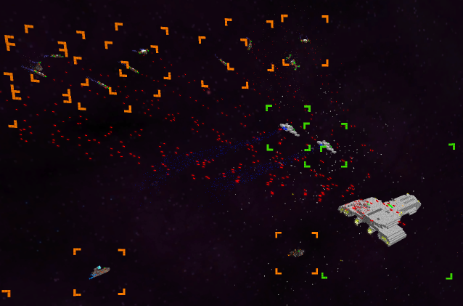
HUD
All HUD elements are made up of Voxels
Text is created with out own Voxelfont
All HUD Elements are located on a Sphere around the Camera

Slide 2
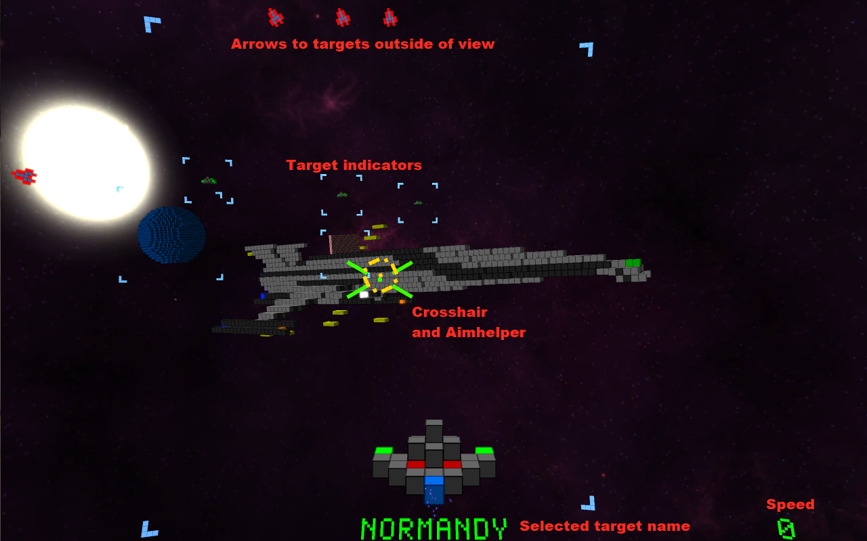
HUD explained

Slide 3
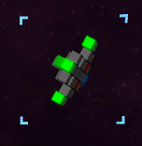

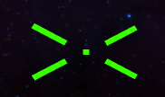
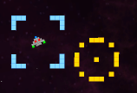

Hudgets
HUD is composed of different elements called „Hudgets“ (HUD-Widgets)
All Hudgets can update their own position and appearance, according to the game situation.
ObjectHudgets mark other Worldobjects
Crosshair
AimHelper indicates where to aim, to hit a moving object
TextHudgets and Buttons

Slide 4
Spherical HUD
HUD elements are placed on a sphere around the camera
Sphere (supposivly) allows easy integration with Oculus Rift
Creates a „HUD on Helmet“ illusion
Spherical HUD creates problems on the Rift for hudgets outside of the focus.
Due to the different viewing angles and distance to hudgets along the edges, the hudgets appear twice.

